Slide 1

California School Climate, Health, and Learning Surveys (CalSCHLS): Progress Update
December 8, 2020
Note: The research reported here was supported by the Institute of Education Sciences, U.S. Department of Education, through Grant R305E150006 to the Regents of the University of California. The opinions expressed are those of the authors alone and do not represent views of the Institute or the U.S. Department of Education, or of the agencies providing data.

Slide 2
Questions and Problems -Secondary
Exclude schools where response rate is low - if a certain year response rate is low, do we exclude only that year? Or do we want an average response rate across years and exclude from all years?
Enrollment data is whacky - people can choose not to report race/ethnicity.
Consistently around 6% in the enrollment data do not report ethnicity
race/ethnicity data has problems
105 schools with total hispanic survey responses > total hispanic enrollment
92 schools with total asian survey responses > total asian enrollment
Same problem with blacks for 299 schools
Same problem with whites for 316 schools

Slide 3
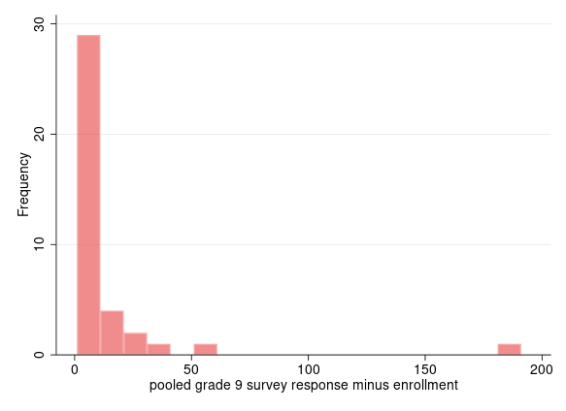
Discrepancy for Pooled Grade 9: bin width = 10

Slide 4
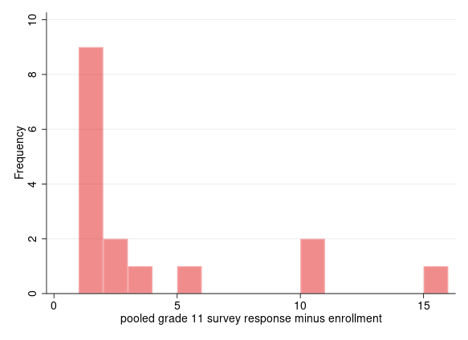
Discrepancy for Pooled Grade 11: bin width = 1

Slide 5
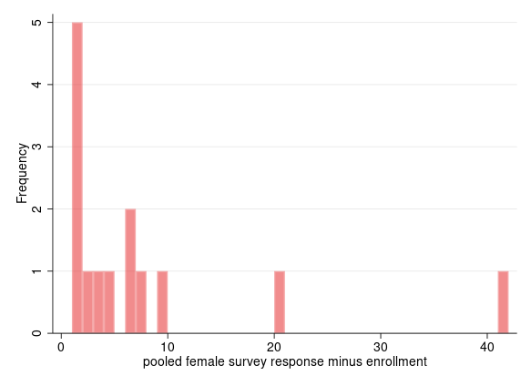
Discrepancy for Pooled Female: bin width = 1

Slide 6
As we can see, the discrepancy for overall pooled data by grade/gender is not severe
Pooled ethnicity data is where the main discrepancy is

Slide 7
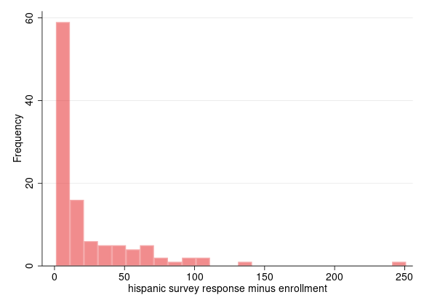
Discrepancy between Survey and Enrollment
Hispanic: Bin width = 10

Slide 8
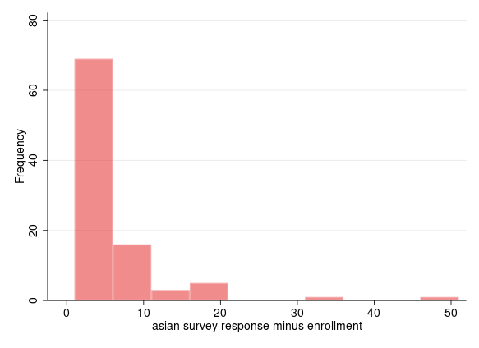
Discrepancy between Survey and Enrollment
Asian: bin width = 5

Slide 9
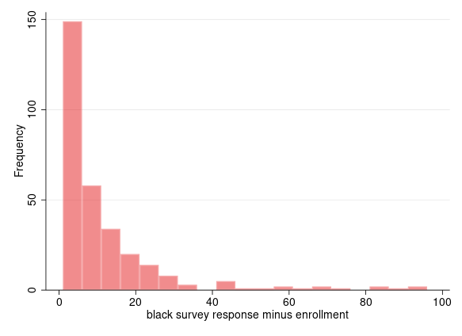
Discrepancy between Survey and Enrollment
Black: bin width = 5

Slide 10
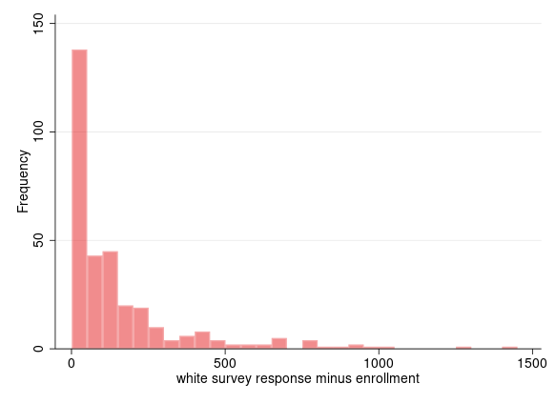
Discrepancy between Survey and Enrollment
White: most severe problem
Bin width = 50

Slide 11
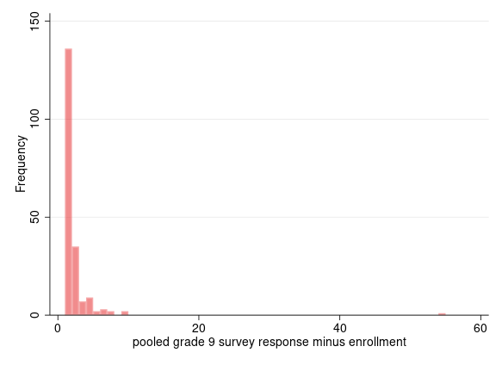
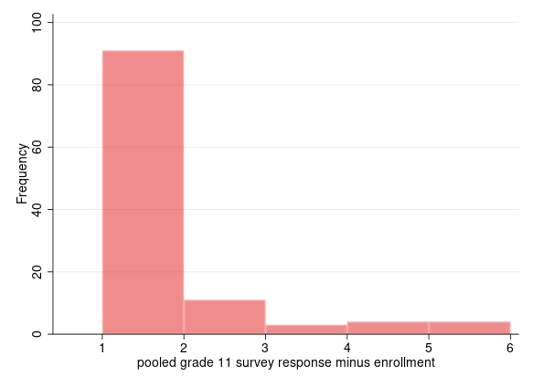
Parent Data has lower discrepancy, but higher frequency

Slide 12
Thank you!
California Department of Education
Jonathan Isler
Ryan Fuller
California Community Colleges Chancellor’s Office
Gary Adams
Todd Hoig
California State University Chancellor’s Office
Ed Sullivan
Matthew Case
Note: The research reported here was supported by the Institute of Education Sciences, U.S. Department of Education, through Grant R305H150073 to the Regents of the University of California. The opinions expressed are those of the authors and do not represent views of the Institute or the U.S. Department of Education, or of the agencies providing data.

